Slide 1
Office 365 Development
July 2014

Slide 2
Course Agenda
Introduction to Office 365 Development
Module 1: Deep Dive Apps for Office in Outlook
Module 2: Deep Dive Apps for Office in Word
Module 3: Deep Dive Apps for Office in PowerPoint
Module 4: Deep Dive Apps for Office in Excel
Module 5: Deep Dive into SharePoint Hosted Apps
Module 6: Deep Dive into Provider Hosted Apps
Module 7: Deep Dive into Security and OAuth
Module 8: App Lifecycle Management

Slide 3
Deep Dive into SharePoint-Hosted Apps
Speaker
Speaker

Slide 4

Agenda
Introduction
Programming in JavaScript
App Parts
UI Custom Actions

Slide 5
Agenda
Introduction to Document-based App Development
Reading and Writing to a Document
Creating Bindings within a Document
Creating an App for Office that uses Custom XML
Design Guidelines for Document-centric Apps

Slide 6
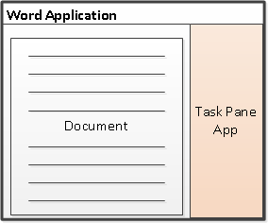
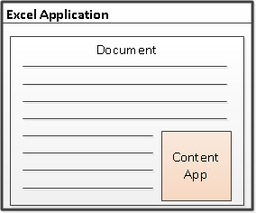
Shapes for Document-based Apps for Office
Task Pane App
Positioned to right of document
Used to assist user working with document
Can search and retrieve content from Internet
Content App
Adds content inline into position within document
Document is always an Excel workbook
Content app can read and write document contents
Notes:
There are two basic styles (i.e. shapes) for creating an app for Office.
A task pane app is positioned to right of document in a style that is familiar to experience Officers users. A task pane app is typically used to assist a user working with a specific document. For example, a task pane app can be designed to search and retrieve content from Internet that can be inserted into the document.
A content app is designed to add its content inline into a position within current document. Note that content apps are only supported into Excel so that document is always an Excel workbook. The content app must be added to a specific worksheet within a workbook. The content app can read and write contents to cells within the same workbook.

Slide 7
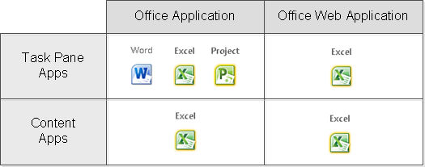
Support for Document-based Apps
Notes:
The matrix on the slide above shows which types of Apps for Office are available in specific Office applications.
Task pane apps can be created for Office Applications including Word, Excel and Project. A task pane app created for Excel can also be used in the Web-based version of Excel and run through the browser.
Content apps can be created for Excel. A content app created for Excel can also be used in the Web-based version of Excel and run through the browser.

Slide 8
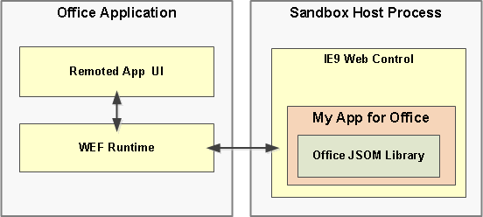
Apps for Office – Office Application Architecture
Apps for Office code run in separate sandboxed process
Sandbox infrastructure leverages Web Control from IE9/IE10
App for Office support for HTML5 and CSS3 consistent with IE9/IE10 support
Notes:
For Office 2013 application (i.e. rich clients), apps are supported by integrating an in-process component, the Office 2013 Web Extensibility Framework runtime, to manage the WEF component lifecycle and enable interoperability between the WEF component and the Office 2013 application. The WEF component’s Web page itself is hosted out-of-process inside a browser control, which in turn is hosted inside a sandboxed process that provides security and performance isolation. The Web Extensibility Framework runtime manages interprocess communication, the translation of JavaScript API calls and events into native ones, as well as UI remoting support to enable the WEF component to be rendered inside the document or Office 2013 application.

Slide 9
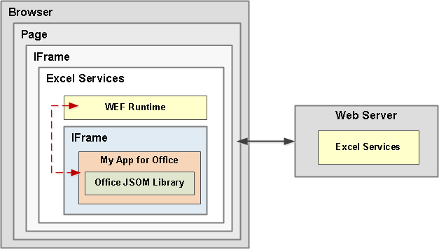
Apps for Office – Office Web Application Architecture
Browser-rendered Apps based on Web standards
Works across all popular browsers (might require the latest version)
App runs its it own iFrame inside outer an iFrame with WEF runtime
Communications between iFrames relies on HTML5 postMessage API
Notes:
For Office 2013 Web Apps, WEF components are hosted inside an IFrame. WEF component support is enabled in the Web Apps by the integration of the Office JavaScript library that, in a similar fashion to the rich client applications, manages of the WEF component lifecycle and interoperability between the WEF component and the Web App, which for the browser requires a special cross-frame communication infrastructure. The same Office JavaScript library used on rich clients supports the APIs available to the WEF component code to interact with the Web App.

Slide 10
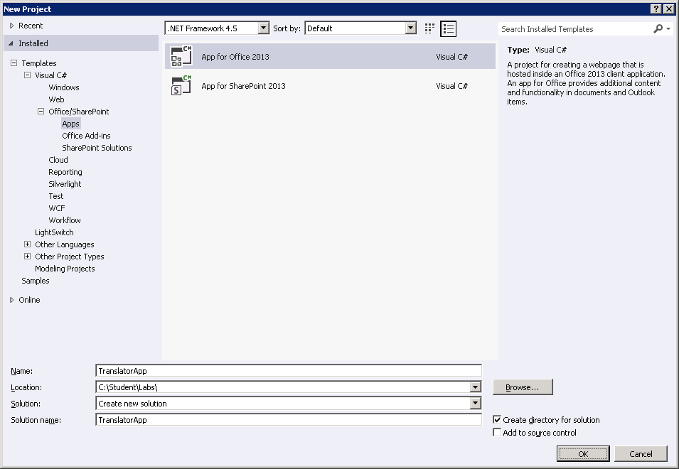
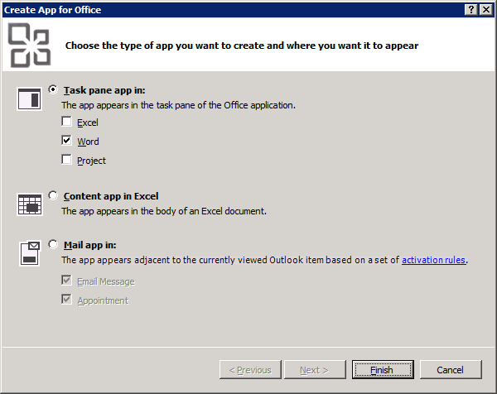
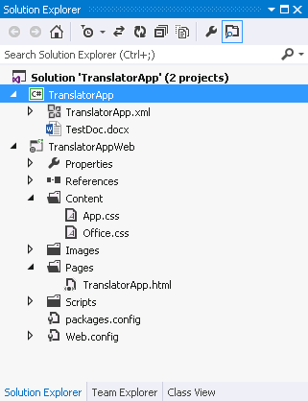
App Development with Visual Studio 2012 RC
Create new App for Office using the Apps for Office 2013 project template
Visual Studio create a new solution with two projects
Top project includes the app manifest for installation into a catalog
Bottom project is ASP.NET Website project know as Remote Web project
Modify Remote Web project source files with HTML, CSS and JavaScript
Press {F5} to test and debug
Notes:
To create a new document-based app for Office, you can use Visual Studio 2012 and the new project templates available for creating apps for Office. When you create the new project, Visual Studio 2012 prompts you to configure project options. You implement the app by modifying source files with HTML, CSS and JavaScript. Visual Studio 2012 makes it easy to test and debug an app by simply pressing the {F5} key as with other types of Visual Studio projects.

Slide 11




A common API for document-based Apps
Document-based Apps for Office have common objects
Used to read and write content to and from document
Used to create bindings and event handlers
Common Objects x-Office!
Picture
Charts
Clip Art
Hyperlink
Text
Table
Matrix
XML Parts
Word Art
Shapes
Notes:
Office 2013 provides a common JavaScript API for developing document-based apps. This API provides a common set of objects used to read and write content to and from document. The common API can also be used to create bindings and event handlers. Note that with Office 2013, the common API is only used across Word and Excel but there are plans to expand the common API and have it used by additional Office applications in later versions.

Slide 12
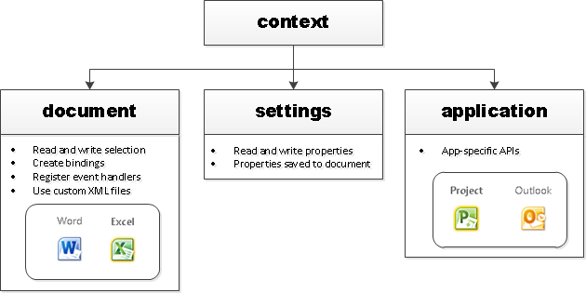
Core API Objects
Office.context
Entry point into Office API
Office.context.document
Common document API
Office.context.settings
Custom properties saved within document
Office.context.application
App-specific APIs (e.g. Project JSOM)
Notes:
The Office JavaScript object model provides a top-level object named Office with a context property which provides your entry point into the API. The context property provides three properties which expose the following objects.
Office.context.document provides access to the current document.
Office.context.settings provides access to a custom property bag allowing the developer to save and retrieve custom property settings
Office.context.application provides access to the entry points for app-specific APIs such as the APIs used to program against Microsoft Project and Outlook

Slide 13
Agenda
Introduction to Document-based App Development
Reading and Writing to a Document
Creating Bindings within a Document
Creating an App for Office that uses Custom XML
Design Guidelines for Document-centric Apps

Slide 14
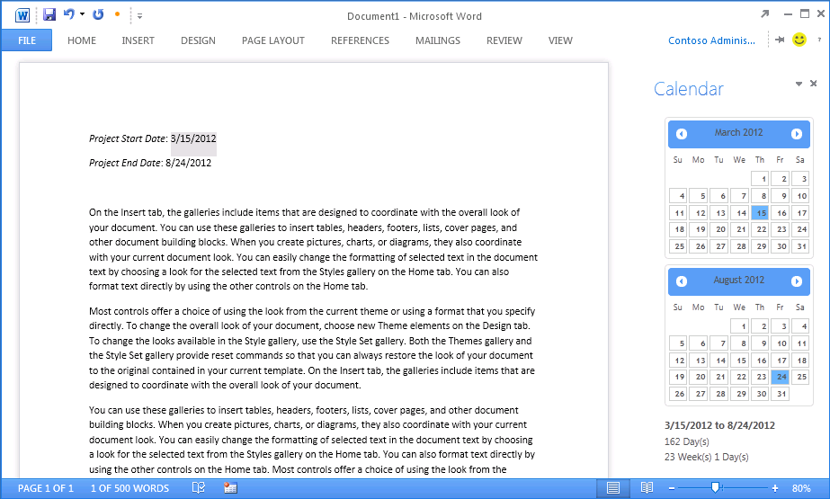
Interacting With Document Content
All data access starts through document object
Read/write access to user selection
Event handler for selection change event
Three data types are supported
Text
Matrix
Table
Notes:
All data access with word documents and excel workbooks starts through the Office.context.document object. It provides functions to read content from a document and to write content to a document based on the current selection. The document object also provides the means to wire up event handlers to fire when the user changes the current selection.
There are three primary data types that are supported when reading and writing data.
Text is a data type that represents a simple text value.
Matrix is a data type that supports a static 2D array of rows and columns.
Table is a data type that supports a dynamic 2D array with named columns and a set of rows where rows and be added and deleted.

Slide 15
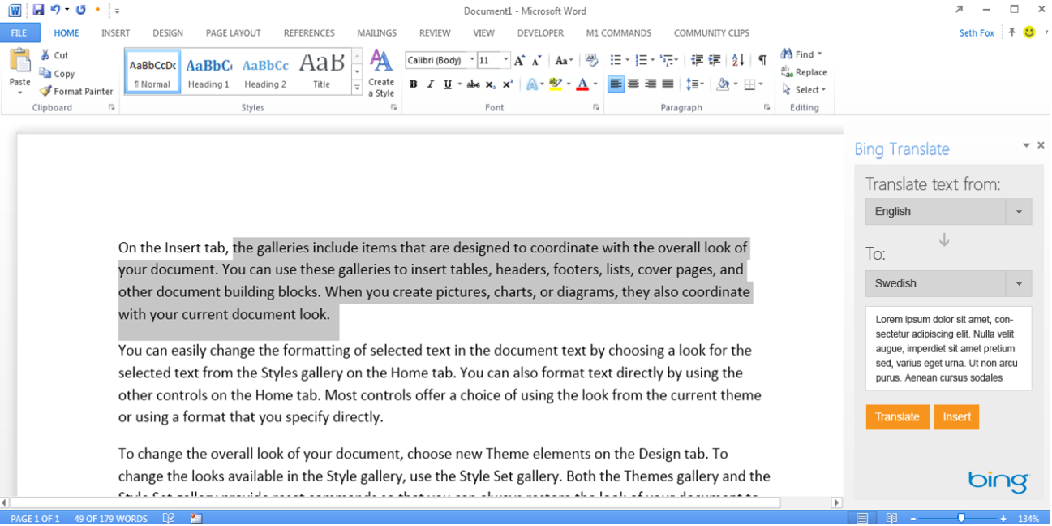
Working with ”text” Selections
Current selection
Task Pane App reads current selection and translates
Notes:
The Text data tyle is used for simple data interactions. For example, it can be used to read and write the current selection in a word document.
To read and write text to and from a document, you can use the methods available through the document object named getSelectedDataAsync and setSelectedDataAsync.
There are also events available through the document object. For example, you can register a JavaScript function as a event handler by calling the addHandlerAsync to register that function to receive callback when the SelectionChanged event is fired. You can unregister that same event handler using the removeHandlerAsync method.
am

Slide 16
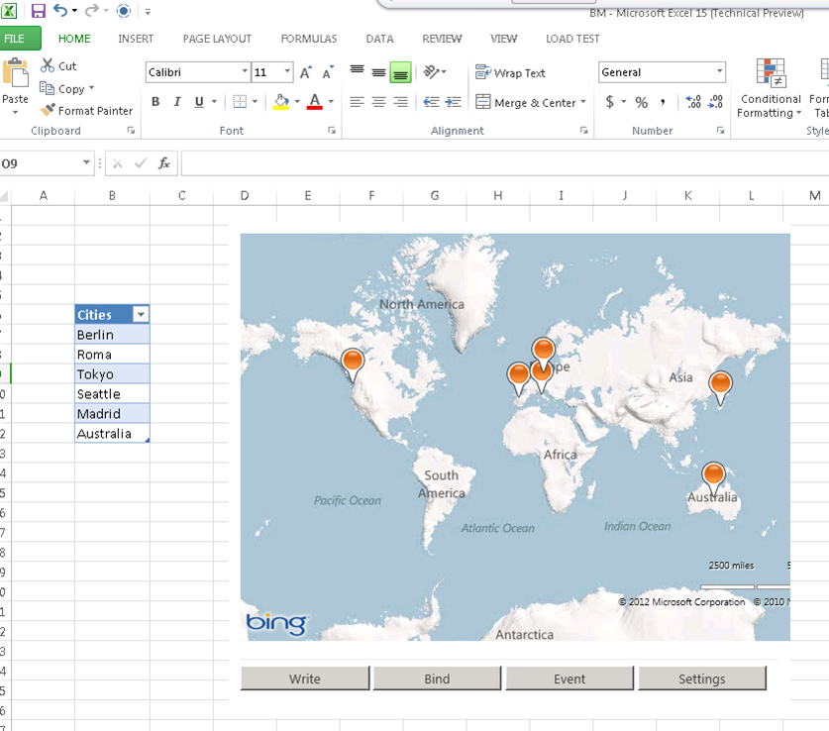
Working with ”table” Selections
Current selection
Content App reads current selection and translates
Notes:
When working with task apps and content apps in Excel, it often makes sense to work with tables instead of simple text. This makes it possible to see a range of cells as a single data item with respect to reading and writing as well as hooking up an event handler to detect changes by the user. A table also provides the user with the ability to add or delete rows which can trigger code inside the app to respond to those changes.
Content within a Table object can be accessed using the getSelectedDataAsync method and setSelectedDataAsync method. You can also register an event handler for the SelectionChanged event specific to single table instead of registering for the same event at the document level.

Slide 17
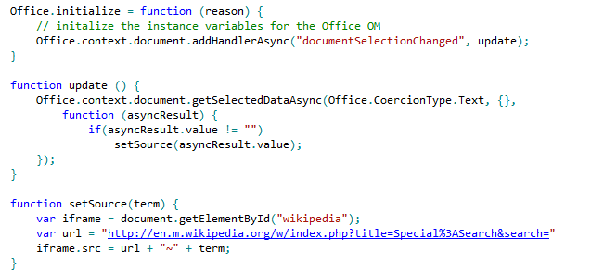
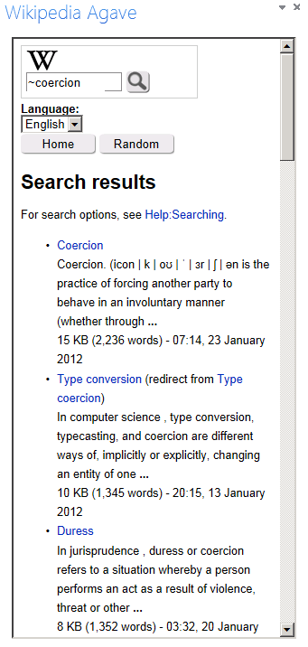
Getting Selected Data
Notes:
The code in this slide shows a simple approach to reading content from a word document. The Office.initialize function has been implemented to register an event handler function named update that fires any time the user changes the selection in the current document. The update function reads the current selection using the getSelectedDataAsync function using a coercion type of text and provides an anonymous function as the callback function which calls the setSource function passing the value of the current selection. The setSource function appends the value of the current selection into a query string parameter at the end of an URL that does a lookup on the Wikipedia Web site and the results are added as the contents of an iFrame so they can be seen by the user.

Slide 18

Setting Selected Data
setSelectedDataAsync (data, {coercionType, asyncContext}, callback)
Use asyncResult parameter in callback function to verify call was successful
Passing data to setSelectedDataAsync
For text shape, pass data as string
For matrix shape, pass data using 2 dimensional JavaScript array
For table shape, pass data using TableData object
Coercion types can be used to convert string to/from HTML and OOXML
Dealing with table size when inserting data
If single cell selected: table of any size can be written
If range selected range, supplied array must match size of table being written
Notes:
You should use the document's setSelectedDataAsync method to write content back to a document. When calling the setSelectedDataAsync function, you will pass a callback function and use the asyncResult parameter in this callback function to verify call was successful
You must determine how to pass data when calling setSelectedDataAsync. For text shape, you can pass data as a string. For matrix shape, you should pass the data using 2 dimensional JavaScript array. For a table shape, you should pass the data using a special TableData object which can be created using the Office JavaScript API. Also note that with Word you can also use two additional coercion types which are HTML and OOXML.
There are a few tricks you should know about when dealing with matrix and table size when inserting data. If the user has selected a single cell selected, a matrix or table of any size can be written. However, if the user has select a range with two or more cells, the matrix or table be written must match the size of target range exactly with respect to the number of rows and columns.

Slide 19
Coercion Types
Content in binding/selection can be converted on read/write
Text
Matrix
Table
HTML
Office Open XML (OOXML)
Office.context.document.getSelectedDataAsync(‘ooxml’, etc…)
Notes:
There are five possible coercion types. In some cases, it should be obvious whether to use Text, Matric or Table. Note that HTML and OOXML are advanced coercion types that are only support in Word 2013 and not in Excel.

Slide 20
Reading and Writing to a Document
demo

Slide 21
Agenda
Introduction to Document-based App Development
Reading and Writing to a Document
Creating Bindings within a Document
Creating an App for Office that uses Custom XML
Design Guidelines for Document-centric Apps

Slide 22
What are App Bindings?
Bindings link an App for Office to a specific document section
Can be defined current selection of a named item in a template
Arbitrarily read/write binding data at anytime
R/W operations do not depend on a selection.
Enable Event handling
Bindings support three different data shapes
Text binding for binding to an individual cell in Excel or text in word.
Matrix binding for a two dimension array representing rows and columns
Table binding is like a matrix binding with support for headers
Notes:
Bindings are a valuable concept because they link an app to a specific section within a document. A binding can be created based on the current selection. A binding can also be defined used a named item such as a named range in an Excel workbook or a bookmark in a Word document. A binding adds value by providing a named section that can be read from or written to regardless of what the current selection is. A binding also support events so you can add an event handler that detects when the user has made a change to the content inside a binding.
Bindings support three different data shapes. Text bindings are used for binding to an individual cell in Excel or text in word. Matrix bindings are used for a two dimension array representing rows and columns. Table bindings are used to support Excel tables with named columns and a set of rows that support inserts and deletions by the user.

Slide 23
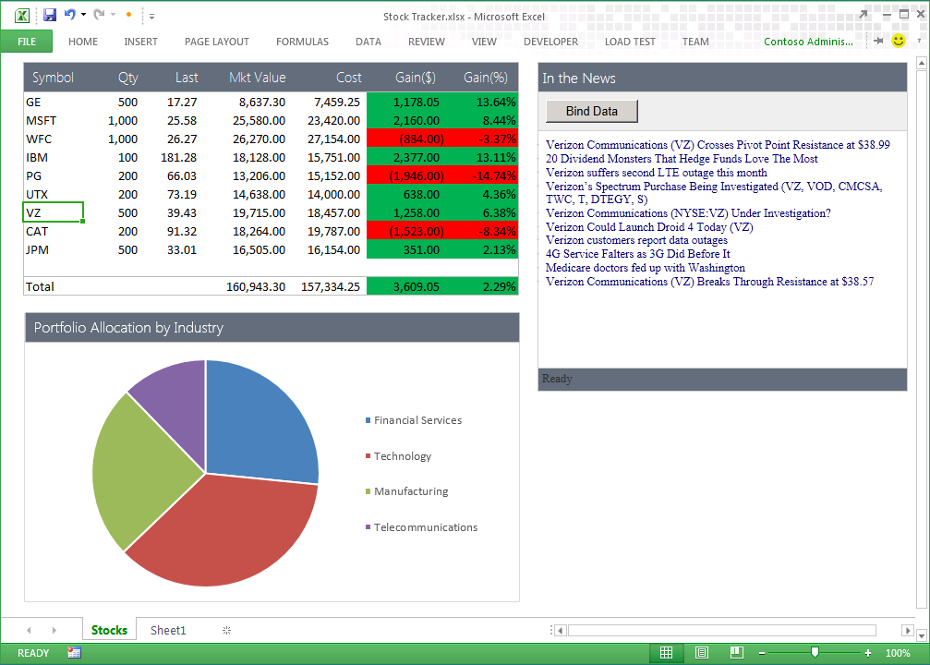
Uses of Apps for Office Bindings
App handles SelectionChanged event associated with the binding to retrieve news associated with stock symbol
Bound range of stock symbols
Notes:
Bindings provide a scope which allows an app to distinguish between selection changes or updates at the document level or just within a specific section of a document. Therefore, bindings can bridge the gap between Office documents and the cloud. Bindings are also key in reading and writing data and detecting changes made by the user.

Slide 24
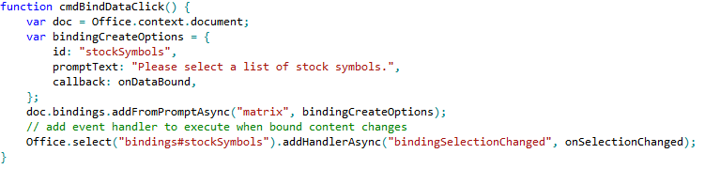
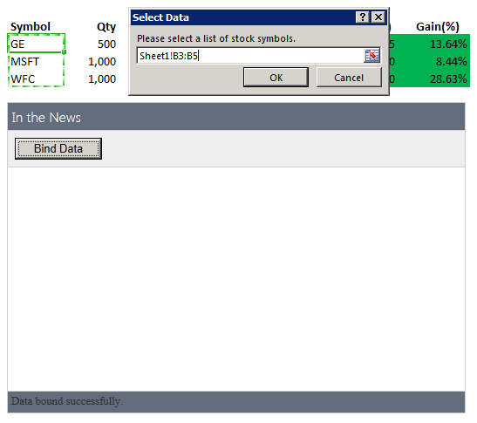
Using Bindings
Adding a binding
Bindings.addFromPromptAsync
Bindings.addFromSelectionAsync
Bindings.addFromNamedItem
Referencing a binding
Bindings.getAllAsync
Bindings.getByIdAsync
Office.Select
Removing a binding
Bindings.releaseByIdAsync
Binding event handler to a binding
Binding.addHandlerAsync(“type”, handler);
A dialog is presented to the user experience when you call addFromPromptAsync.
Notes:
To add a binding, you should use one of the following method
Bindings.addFromPromptAsync
Bindings.addFromSelectionAsync
Bindings.addFromNamedItem
You will also need to reference bindings to read and write content and register event handlers. When you need to reference a binding, you can use one of these method.
Bindings.getAllAsync
Bindings.getByIdAsync
Office.Select
If you ever need to remove a binding, you can use this methods.
Bindings.releaseByIdAsync
To register an event handler on a binding, you can use the following method.
Binding.addHandlerAsync(“type”, handler);

Slide 25
Binding to Cells and Tables in Excel Spreadsheets
demo

Slide 26
Agenda
Introduction to Document-based App Development
Reading and Writing to a Document
Creating Bindings within a Document
Creating an App for Office that uses Custom XML
Design Guidelines for Document-centric Apps

Slide 27
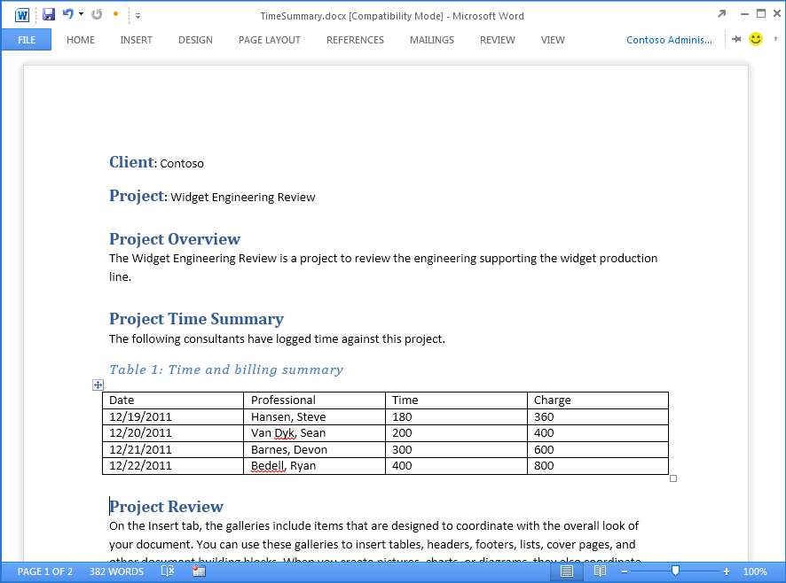
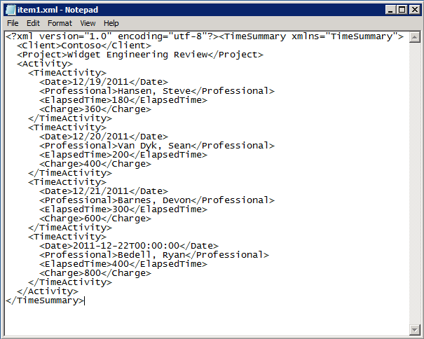


Open XML and Content Control Refresher
The TimeSummary document contains custom XML document
Inner XML document contains elements bound to Word Content Controls
Custom XML document can be modified/updated by your app
Custom XML document can be modified by user input
Word file structure
_rels
customXml
Content Controls mapped to custom XML part
docProps
word
Content Types
Notes:
Microsoft Word intorduced Content Controls in Office 2007. Content controls act as containers and user input controls for specific kinds of content. A valuable role of content controls is that they can be mapped to nodes within a custom XML part which is an XML document with custom content which is embedded within a Office document such as a DOCX file..
With Office 2013, there is a new content control for repeating sections. A Repeating Section content control provides the capability to bind to a collection of nodes which typically represent the many side on a one-to-many relationship as in the case where a single time summary document has many time activity entries.

Slide 28
App for Office Support for Custom XML Parts
Things an App for Office can do
Add/delete custom XML parts
Get XML parts
Get/set node values
Event handlers for node deleted, inserted, or replaces
Core objects for working with custom XML parts
CustomXmlPart
CustomXmlParts
CustomXmlNode
CustomXmlPrefixMappings
Notes:
Since Office 2007 introduced files built using the Office Open XML structure, Microsoft Word has supported embedding one or more custom XML documents within a DOCX file known as a custom XML part. A task pane app can be written to add, replace, update or delete a custom XML part. An app can also retrieve a specific XML part using an XML namespace and get or set specific node values. Furthermore, an app can register an event handler that fires whenever there is a user action which results in a node being deleted, inserted, or replaced.
The Office API provide a core set of objects for working with custom XML parts which includes the following.
CustomXmlPart
CustomXmlParts
CustomXmlNode
CustomXmlPrefixMappings

Slide 29
Working with Custom XML and Content Controls in a Word Document
demo

Slide 30
Agenda
Introduction to Document-based App Development
Reading and Writing to a Document
Creating Bindings within a Document
Creating an App for Office that uses Custom XML
Design Guidelines for Document-centric Apps

Slide 31
User Experience Guidelines
Recommended guidelines
Use Office styles
Microsoft to publish User Experience Guidelines documentation
Design and Test for All Scenarios
Rich client, Browser, Tablet and Mobile
Decide which technology makes sense
Weigh pros and cons between HTML5, Silverlight and Flash
Notes:
Microsoft has published recommended guidelines for designing and implementing document-based apps for Office. These guidelines include using Office styles and user interface experience standards. You should keep in mind that you must design and test all the scenarios you plan to support which might include UI experience for the browser, for tablets and mobile devices in addition to the UI experience in the standard Office applications themselves.
You should also consider and make decisions about which Web technology makes sense to use. While HTML5 makes the most sense, you should understand that other Web technologies such as Silverlight and Flash can also be used in specific scenarios to achieve what cannot be done or what cannot be done easily with HTML5.

Slide 32
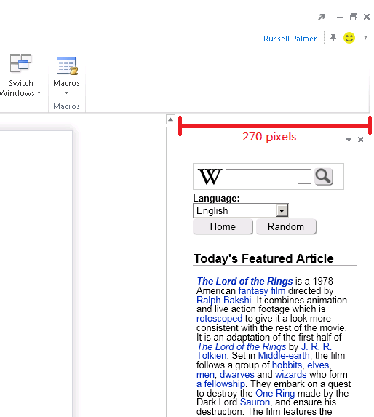
Guidelines for Designing Task Pane Apps
Layout Guidance
Default width of 270 pixels
Developer cannot change width
Users can resize width of task pane
Context Menus
Developer has control of context menu inside an App
Developer has no control over Office Task Pane menu
Scrollbar Guidance
Horizontal scrollbars should be avoided.
Vertical scrollbars are acceptable if required
Use CSS to match styles of Office 2013 scrollbar
Notes:
Microsoft has made specific recommendations for task pane apps with regard to layout guidance. The default width of a task pane app is 270 pixels. As a developer you cannot change that width with HTML, CSS or JavaScript. To make things even more challenging, the user can resize the width of the task pane which will resize your task pane app. Therefore, make sure you test your app by resizing and ensure that the user experience does not break down.
As a developer of a task pane app, you can add custom menus to the context menu of an app located at the top-right corner. However. You have no control over the top-level Office Task Pane menu nor do you have control over any other menus within the Office UI.
There is also strict guidance with respect to scrollbars. Horizontal scrollbars should be avoided at all costs. You should also try an avoid the user of vertical scrollbars is possible but here use is acceptable if required. Remember to use the styles inside the styles.css file to match styles of standard Office 2013 scrollbar.

Slide 33
Guidelines for Designing Content Apps
Layout Guidance
Content apps have generous size (max of 2560 x 2048)
Users can resize and move so design accordingly
Remember – content may print with the document
Context Menus
Developer has control of the context menu inside an app
However, you can not take over, or add to the Shape context menu.
Scrollbar Guidance
Scrollbars should be avoided within a Content App
Size them appropriately within the manifest.
Notes:
Microsoft has made specific recommendations for content apps with regard to layout guidance. You must specify the width and height for a content app and the max size and width are quite large. The max width is 2560 pixels and the max height is 2048 pixels, As a developer you cannot change that width and height after the content app has been added so make sure it is large enough to begin width. Also keep in mind that the user can resize the width and height of ac content app. Therefore, make sure you test your app by resizing and ensure that the user experience is the best it can be.
As a developer of a content app, you can add custom menus to the context menu of an app located at the top-right corner. However. You have no control over any other menus within the Office UI.
There is also strict guidance with respect to scrollbars. All scrollbars should be avoided at all costs, period. If you feel that you need scrollbars, then you need to make the initial width and height larger so your app does not require them.

Slide 34
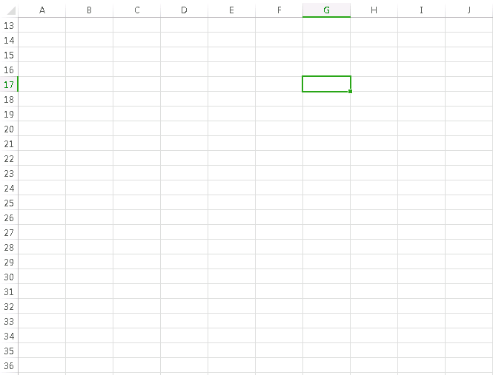
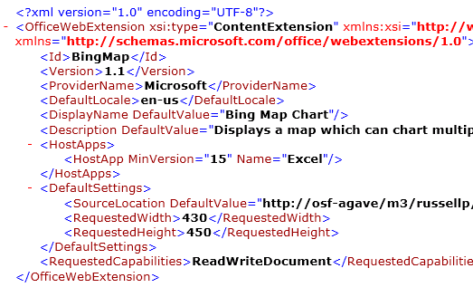
Guidelines for Designing Content Apps
Set an appropriate size
Specify an appropriate size for the App in the Manifest
This example is sized to small
resize to avoid scrollbars
Notes:
It important when designing a content app to set an appropriate size for a width and height in in the app manifest. This example shows an example of a content app that has been sized to small. The width and height should be changed to remove any need for scrollbars.

Slide 35
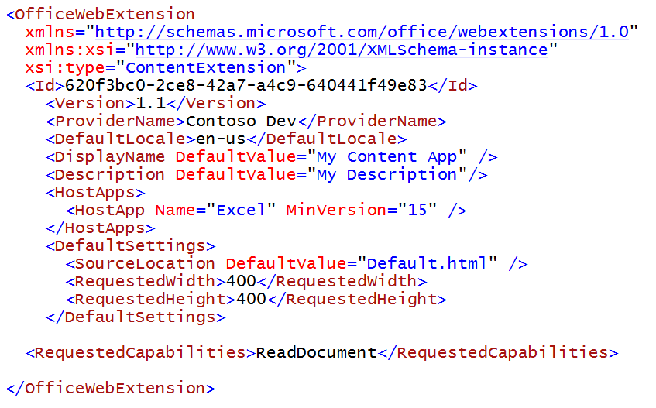
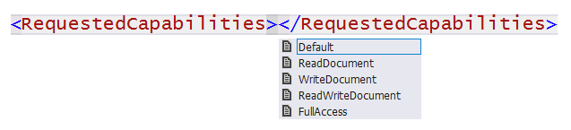
RequestedCapabilities
Default (restricted)
You can read/write document settings
ReadDocument
You have read access to document
You can subscribe to change events
WriteDocument
Write content into document
ReadWriteDocument
ReadDocument + WriteDocument
FullAccess
All Permissions + use of Silverlight & Flash
Notes:
The last things to think about is how much permission an app need to completed its work. You should try and limit the requested permissions to the absolute minimum. It is a design mistake to request more permissions than you app actually needs. Here is a breakdown of the available permission levels you can request in the RequestedCapabiliites element inside the app manifest.
Default (restricted) allows you to read and write document settings but provides no access to the content within the document itself.
ReadDocument allows read access to document as well as read/write access to document settings and the ability to create bindings and register for document level events
WriteDocument allows write access to document at the current selection as well as read/write access to document settings. However the app cannot read any contents of the document itself.
ReadWriteDocument provides the combined permissions of ReadDocument and WriteDocument together
FullAccess provides all permissions of ReadWriteDocument plus the right to use other Web technologies such as Silverlight or Flash within the app.

Slide 36
Summary
Introduction to Document-based App Development
Reading and Writing to a Document
Creating Bindings within a Document
Creating an App for Office that uses Custom XML
Design Guidelines for Document-centric Apps

Slide 37
© 2012 Microsoft Corporation. All rights reserved. Microsoft, Windows, and other product names are or may be registered trademarks and/or trademarks in the U.S. and/or other countries.
The information herein is for informational purposes only and represents the current view of Microsoft Corporation as of the date of this presentation. Because Microsoft must respond to changing market conditions, it should not be interpreted to be a commitment on the part of Microsoft, and Microsoft cannot guarantee the accuracy of any information provided after the date of this presentation. MICROSOFT MAKES NO WARRANTIES, EXPRESS, IMPLIED OR STATUTORY, AS TO THE INFORMATION IN THIS PRESENTATION.

Slide 38
demo
Creating a SharePoint-Hosted App

Slide 39
Programming in JavaScript

Slide 40
Summary
Introduction
Programming in JavaScript
App Parts
UI Custom Actions

Slide 41

© 2012 Microsoft Corporation. All rights reserved. Microsoft, Windows, and other product names are or may be registered trademarks and/or trademarks in the U.S. and/or other countries.
The information herein is for informational purposes only and represents the current view of Microsoft Corporation as of the date of this presentation. Because Microsoft must respond to changing market conditions, it should not be interpreted to be a commitment on the part of Microsoft, and Microsoft cannot guarantee the accuracy of any information provided after the date of this presentation. MICROSOFT MAKES NO WARRANTIES, EXPRESS, IMPLIED OR STATUTORY, AS TO THE INFORMATION IN THIS PRESENTATION.

